Slide 1

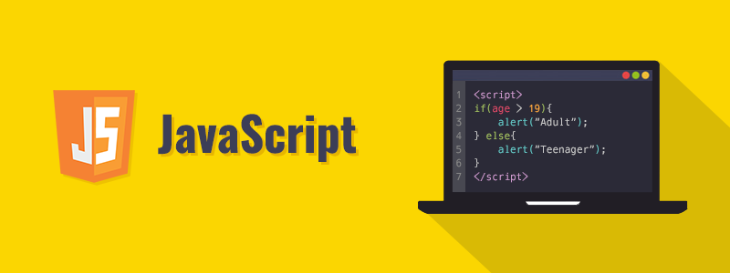
Welcome to JavaScript Advanced
Advanced

Slide 2


JavaScript OOPS :
Object Oriented Programming (OOP)
Object-oriented programming (OOP) is a programming paradigm based on the concept of "Objects", which can contain data in the form of "Attributes", and functionality in the form of "Methods" that are planned and designed using "Classes"
Class (Design)
Object (Product)
Attributes (properties)
Color = gray
Wheels = alloy
Fuel = petrol etc
Instance
Methods (Functioning)
Moving place to place
Playing Music
Playing Movie etc

Slide 3
OOPS Terminology :
What is a Class ?
A Class is a Plan or Blueprint or Model for an Object to be created.
What is an Object ?
An Object is a product which was created according to the plan defined in a Class.
What are Attributes ?
Attributes are the properties that belongs to an Object to be created.
What are Methods ?
Methods refer to the functionality of an Object to be created.
What is an Instance ?
Instance is an event when an Object was created out of its Class.

Slide 4
JavaScript OOPS :
Advantages of OOP Concept :
OOPs makes development and maintenance easier where as in Procedure oriented programming it is not easy to manage if code grows as project size grows.
2. OOPs provides data hiding whereas in Procedure-oriented programming
a global data can be accessed from anywhere.
3. OOPs provides ability to simulate real-world event much more effectively. We can
provide the solution of real word problem if we are using the Object-Oriented
Programming. etc

Slide 5
JavaScript OOPS :
How to create JavaScript Objects :
There are 4 ways to create objects.
1) By using object literal
2) By using an instance of Object directly (using new keyword)
3) By using an object constructor (using new keyword)
4) By using Classes
1) By Object Literal :
Ex : object = { property1 : value1 , property2 : value2 ..... }
var car = {‘name’ : ‘audi’ , ‘model’:2019 , ‘engine’ :’petrol’} → object was created in var car
Accessing Objects :
console.log(car.name)
console.log(car.model)
console.log(car.engine)

Slide 6
JavaScript OOPS :
2) By creating instance of Object directly (using new keyword) :
Ex :
var car = new Object( ) → object was created in var car using new keyword along with direct Object
car.name = ‘audi’
car.model = 2019
car.engine = ‘petrol’
Accessing Objects : console.log(car) → {‘name’ : ‘audi’ , ‘model’:2019 , ‘engine’ :’petrol’}
console.log(car.name)
console.log(car.model)
console.log(car.engine)

Slide 7
JavaScript OOPS :
3) By using an object constructor (using new keyword) :
Ex :
function car(name,model,engine ){ → constructor function
this.car_name = name → ‘this’ keyword referes to current object
this.car_model = model
this.car_engine = engine }
Accessing Objects : x = new car(‘audi’ , 2019 , ‘petrol’)
console.log(x.car_name)
console.log(x.car_model)
console.log(x.car_engine)

Slide 8
JavaScript OOPS :
4) By using Class :
Ex : class car{
constructor(name,model,engine){
this.car_name = name
this.car_model = model
this.car_engine = engine }
work( ) {
return(“moves”) }
music( ) {
return(“plays music”) }
}
Accessing Objects : var a = new car(‘audi’,2019,'petrol’)
var b = new car(‘bmw’,2018,'diesel’)
console.log(a. car_color) console.log(a.work())

Slide 9
JavaScript OOPS :
Assigning Class to a Variable :
Ex : var x = class {
constructor(name,model,engine){
this.car_name = name
this.car_model = model
this.car_engine = engine }
work( ) {
return(“moves”) }
music( ) {
return(“plays music”) }
}
Accessing Objects : var a = new x(‘audi’,2019,'petrol’)
var b = new x(‘bmw’,2018,'diesel’)
console.log(a. car_color) console.log(a.work())

Slide 10
JavaScript OOP Characteristics:
INHERITANCE : Inheritance allows us to define a class that inherits all the methods and properties from another class.
Parent class is the class being inherited from, also called Base class.
Child class is the class that inherits from another class, also called Derived class.
Syntax :
Class parent{
parent properties & methods }
Class child extends parent{
child properties & methods
}
Class grandchild extends child{
grandchild properties & methods }
Ex : class car {
action(){ return(“travel”)}
}
class audi extends car{
audio(){ return(“play music”) }
}
class benz extends audi{
video(){return(“play video”)}
var x = new benz()
console.log(x.action())

Slide 11
JavaScript OOP Characteristics:
POLYMORPHISM : Polymorphism => Poly means (many) and morphism means (forms).
In OOP, the one and same operator or method is used for performing different operations which are called “Operator Overloading” and “Method Overloading” and “Method Overidding”
Note : Method Overloading is not supported in JavaScript
Method Overidding
“Same Method Names”
Ex : class car {
action(){ return(“travel”)}
}
class audi extends car{
action(){ return(“play music”) }
var x = new audi()
console.log(x.action())
+ operator acts as addition
Ex : var a = 10
var b = 20
var result = a+b Operator Loading
var fname = “veera”
var lname = “raghava”
var fullname = fname + lname
+ operator acts as string concatenation

Slide 12
JavaScript OOP Characteristics:
ENCAPSULATION : Encapsulation is the process of protecting class attribues and methods from
accidental modification and it does not allow to access the protected attributes or methods to outside.
Use var keyword to make data members private.
Use setter methods to set the data and getter methods to get that data.
Ex : class student {
constructor() {
var name
var marks }
getName() {
return this.name }
setName(name) {
this.name=name }
getMarks() {
return this.marks }
setMarks(marks) {
this.marks=marks }
}
Getter & Setter :
var x=new student()
x.setName(“sriram")
x.getName()
x.setMarks(90)
x.getMarks()

Slide 13
JavaScript for Front End Web Scripting (DOM Manipulations)

Slide 14
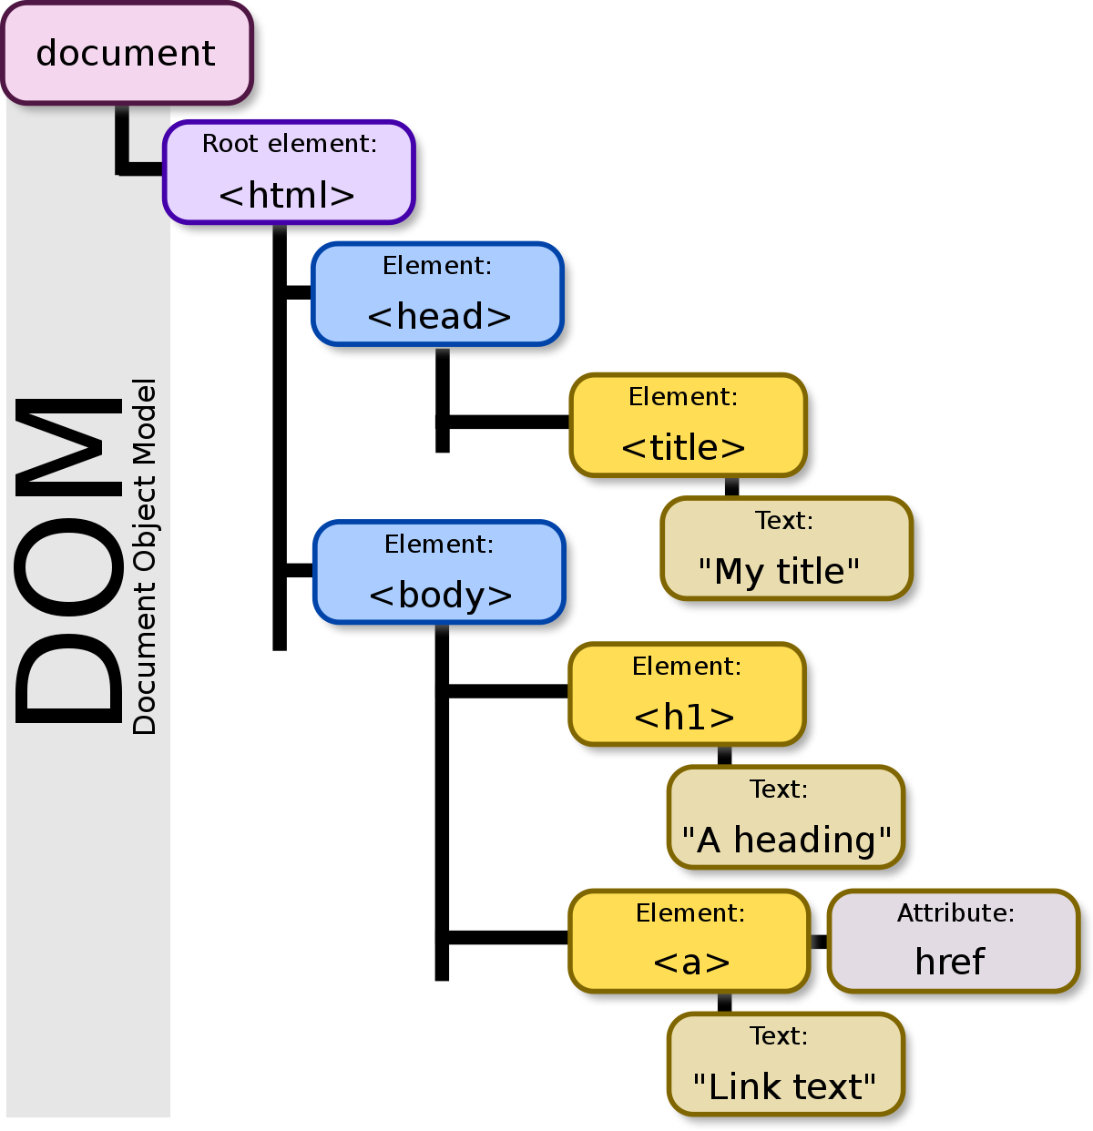
What is DOM :
DOM :- Document Object Model
The DOM is a W3C (World Wide Web Consortium)
standard.
"The W3C Document Object Model (DOM) is a platform and
language-neutral interface that allows programs and scripts
to dynamically access and update the content, structure,
and style of a document.“
When a web page is loaded, the browser creates
a Document Object Model of the page.
Types of DOM : CORE DOM, XML DOM , HTML DOM
By using DOM, JavaScript can access and
change all the elements of an HTML document.
The HTML DOM model is constructed as
a tree of Objects

Slide 15
JavaScript DOM Manipulations :
With the object model, JavaScript gets all the power it needs to create dynamic HTML:
JavaScript can change all the HTML elements in the page
JavaScript can change all the HTML attributes in the page
JavaScript can change all the CSS styles in the page
JavaScript can remove existing HTML elements and attributes
JavaScript can add new HTML elements and attributes
JavaScript can react to all existing HTML events in the page
JavaScript can create new HTML events in the page

Slide 16
HTML DOM :
What is the HTML DOM ?
The HTML DOM is a standard object model and programming interface for HTML.
It defines:
The HTML elements as objects
The properties of all HTML elements
The methods to access all HTML elements
The events for all HTML elements
The HTML DOM is a standard for how to get, change, add, or delete HTML elements.

Slide 17
JavaScript HTML DOM Methods :
HTML DOM methods are actions you can perform (on HTML Elements).
HTML DOM properties are values (of HTML Elements) that you can set or change.
The DOM Programming Interface :
The HTML DOM can be accessed with JavaScript (and with other programming languages).
In the DOM, all HTML elements are defined as objects.
The programming interface is the properties and methods of each object.
A property is a value that you can get or set (like changing the content of an HTML element).
A method is an action you can do (like add or deleting an HTML element).

Slide 18
JavaScript HTML DOM Document :
The HTML DOM document object is the owner of all other objects in your web page.
The document object represents your web page.
If you want to access any element in an HTML page, you always start with accessing the document object.
Ex : Finding HTML Elements :
Method | Description
document.getElementById(id) | Find an element by element id
document.getElementsByTagName(name) | Find elements by tag name
document.getElementsByClassName(name) | Find elements by class name

Slide 19
JavaScript HTML DOM Document :
Ex : Changing HTML Elements :
Property | Description
element.innerHTML = new html content | Change the inner HTML of an element
element.attribute = new value | Change the attribute value of an HTML element
element.style.property = new style | Change the style of an HTML element

Slide 20

DOM Nodes :
JavaScript HTML DOM Elements (Nodes)
According to the W3C HTML DOM standard, everything in an HTML document is a node
The entire document is a Document Node
Every HTML element is an Element Node
The text inside HTML elements are Text Nodes
Every HTML attribute is an Attribute Node
All comments are Comment Nodes
With the HTML DOM, all nodes in the node tree
can be accessed by JavaScript.
New nodes can be created, and all nodes can
be modified or deleted.

Slide 21
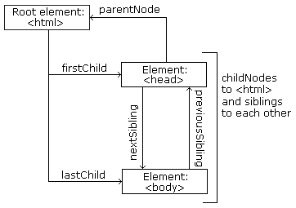
DOM Nodes :
Node Relationships :
The nodes in the node tree have a hierarchical relationship to each other.
The terms parent, child, and sibling are used to describe the relationships.
In a node tree, the top node is called the root (or root node)
Every node has exactly one parent, except the root (which has no parent)
A node can have a number of children
Siblings (brothers or sisters) are nodes with the same parent

Slide 22
JavaScript HTML DOM Document :
Ex : Accessing Nodes :
document.getElementById(“hello").firstChild.nodeValue
document.getElementById(“hello").childNodes[0].nodeValue
Ex : Adding and Deleting HTML Elements :
Method | Description
document.createElement(element) | Create an HTML element
document.removeChild(element) | Remove an HTML element
document.appendChild(element) | Add an HTML element
document.write(text) | Write into the HTML output stream

Slide 23
DOM Events :
Event refers to any activity that occurs in the web page such as :
Button Clicks
Text input
Selections
Key Press
Moving Mouse Pointer
Form submission
Page load etc
All the events can be handled by JavaScript using Event Listeners.
Event Listners can detect Events in the web page and execute JavaScript Statements for achieving desired task.
‘on’ word will be used in front of Events attributes Ex: onclick , onsubmit , onload , onblur etc
Ex : <button type=“button” onclick=“alert(‘Hello World’)” > Click Here </button>

Slide 24
JavaScript
Ex : Adding Even Handlers :
Method | Description
document.getElementById(id).onclick = function(){code} | Adding event handler code to an onclick event

Slide 25
BOM (Browser Object Model) :
The Browser Object Model (BOM) allows JavaScript to interact with the browser.
The Window Object
The Window object is supported by all browsers. It represents the browser's window.
All global JavaScript objects, functions, and variables automatically become members of the window object.
Global variables are properties of the window object.
Global functions are methods of the window object.
Even the document object (of the HTML DOM) is a property of the window object:
Ex:
window.document.getElementById(“id")
or
document.getElementById(“id")

Slide 26
JavaScript Browser BOM :
Window Size
Two properties can be used to determine the size of the browser window.
Both properties return the sizes in pixels:
window.innerHeight : - the inner height of the browser window (in pixels)
window.innerWidth : - the inner width of the browser window (in pixels)
Ex :
window.open () window.moveTo ()
window.close () window.resizeTo ()
document.documentElement.clientHeight
document.documentElement.clientWidth
or
document.body.clientHeight
document.body.clientWidth
var w = window.innerWidth || document.documentElement.clientWidth || document.body.clientWidth; var h = window.innerHeight || document.documentElement.clientHeight || document.body.clientHeight;

Slide 27
JavaScript Browser BOM :
Window Screen
The window.screen object contains information about the user's screen.
screen.width → returns the width of the visitor's screen in pixels.
screen.height → returns the height of the visitor's screen in pixels.
screen.availWidth → returns the width of the visitor's screen, in pixels, minus interface features like the Windows Taskbar.
screen.availHeight → returns the height of the visitor's screen, in pixels, minus interface features like the Windows Taskbar.
screen.colorDepth → returns the number of bits used to display one color.
screen.pixelDepth → returns the pixel depth of the screen.

Slide 28
JavaScript Browser BOM :
Window Location
window.location object can be used to get the current page address (URL) and to redirect the browser to a new page.
window.location.href → returns the href (URL) of the current page
window.location.hostname → returns the domain name of the web host
window.location.pathname → returns the path and filename of the current page
window.location.protocol → returns the web protocol used (http: or https:)
window.location.assign → loads a new document

Slide 29
JavaScript Browser BOM :
Window History
window.history object contains the browsers history.
To protect the privacy of the users, there are limitations to how JavaScript can access this object.
Some methods:
history.back() → same as clicking back in the browser
history.forward() → same as clicking forward in the browser

Slide 30
JavaScript Browser BOM :
Window Navigator
window.navigator object contains information about the visitor's browser.
navigator.cookieEnabled → property returns true if cookies are enabled, otherwise false
navigator.appName → property returns the application name of the browser
navigator.appCodeName → property returns the application code name of the browser
navigator.product → property returns the product name of the browser engine
navigator.appVersion → property returns version information about the browser
navigator.userAgent → property returns the user-agent header sent by the browser to the server
navigator.platform → property returns the browser platform (operating system)
navigator.javaEnabled () → method returns true if Java is enabled

Slide 31
JavaScript Browser BOM :
JavaScript has three kind of popup boxes: Alert box, Confirm box, and Prompt box.
Alert Box
An alert box is often used if you want to make sure information comes through to the user.
When an alert box pops up, the user will have to click "OK" to proceed.
Ex : window.alert(“Hello") or alert(“Hello”)
Confirm Box
A confirm box is often used if you want the user to verify or accept something.
When a confirm box pops up, the user will have to click either "OK" or "Cancel" to proceed.
If the user clicks "OK", the box returns true. If the user clicks "Cancel", the box returns false.
Ex : window.confirm("is info is ok ?") or confirm(“is info is ok ?”)
Prompt Box
A prompt box is often used if you want the user to input a value before entering a page.
When a prompt box pops up, the user will have to click either "OK" or "Cancel" to proceed after entering an input value.
If the user clicks "OK" the box returns the input value. If the user clicks "Cancel" the box returns null.
Ex : window.prompt () or prompt ()

Slide 32
JavaScript Browser BOM :
JavaScript Timed Events
The Window object allows execution of code at specified time intervals.
These time intervals are called timing events.
The two key methods to use with JavaScript are:
1) setTimeout(function,milliseconds) → Executes a function, after waiting a specified number of milliseconds.
2) clearTimeout(variable) → method stops the execution of the function specified in setTimeout().
3) setInterval(function, milliseconds) → Same as setTimeout(), but repeats the execution of the function continuously.
4) clearTimeInterval(variable) → method stops the executions of the function specified in the setInterval() method.

Slide 33
JavaScript Browser BOM :
Cookies
Cookies represents the user data.
When a browser requests a web page from a server, cookies belonging to the page are added to the request.
Cookies are saved in name-value pairs ( username = sriram)
By default, the cookie belongs to the current page.
Ex :
document.cookie = "username=sriram“
document.cookie = "username=sriram; expires=Thu, 18 Dec 2013 12:00:00 UTC"
document.cookie = "username=sriram; expires=Thu, 18 Dec 2013 12:00:00 UTC; path=/"
var x = document.cookie
document.cookie = "username=siva; expires=Thu, 18 Dec 2013 12:00:00 UTC; path=/"
document.cookie = "username=; expires=Thu, 01 Jan 1970 00:00:00 UTC; path=/;"

Slide 34
JavaScript
Form Validation :
HTML Form is the way to collect user information and pass on to the server for further processing.
User should give his correct data in correct format and user must fill all the required fields in the form.
If user does not enter correct data or misses filling up any field then it results in sending partial
information to the server which will result in wrong processing at server side.
Due to this, much of the server resources like load,unnecessary traffic increases.
To avoid such problems we must and should use FORM VALIDATION at client side itself and prompt the user to input correct data and fill up all the required fields.

Slide 35
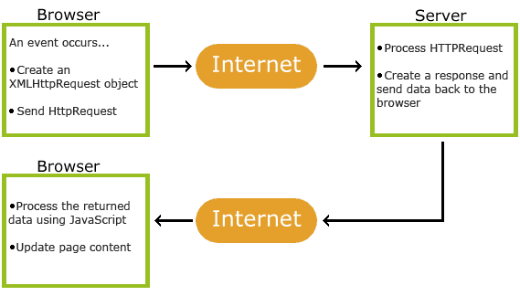
What is AJAX ?
AJAX = Asynchronous JavaScript And XML.
AJAX is not a programming language.
AJAX just uses a combination of:
A browser built-in JavaScript XMLHttpRequest object (to request data from a web server)
and HTML DOM (to display or use the data)
AJAX allows web pages to be updated asynchronously by exchanging data with a web server behind the scenes. This means that it is possible to update parts of a web page, without reloading the whole page.

Slide 36
AJAX :
XMLHttpRequest Object Methods
Method | Description
new XMLHttpRequest() | Creates a new XMLHttpRequest object
open(method, url, async, user, psw) | Specifies the request method: the request type GET or POST url: the file location async: true (asynchronous) or false (synchronous) user: optional user name psw: optional password
send() | Sends the request to the server Used for GET requests
send(string) | Sends the request to the server. Used for POST requests

Slide 37
AJAX :
XMLHttpRequest Object Properties
Property | Description
onreadystatechange | Defines a function to be called when the readyState property changes
readyState | Holds the status of the XMLHttpRequest. 0: request not initialized 1: server connection established 2: request received 3: processing request 4: request finished and response is ready
responseText | Returns the response data as a string
responseXML | Returns the response data as XML data
status | Returns the status-number of a request 200: "OK" 403: "Forbidden" 404: "Not Found"
statusText | Returns the status-text (e.g. "OK" or "Not Found")

Slide 38
AJAX :
<html>
<body>
<div id=“hello">
<h2>The XMLHttpRequest Object</h2>
<button type="button" onclick="loadDoc()">Load Data</button>
</div>
<script>
function loadDoc() {
var xhttp = new XMLHttpRequest();
xhttp.onreadystatechange = function() {
if (this.readyState == 4 && this.status == 200) {
document.getElementById(“hello").innerHTML =
this.responseText;
}
};
xhttp.open("GET", “data.txt", true);
xhttp.send();
}
</script>
</body>
</html>
Ex :

Slide 39
What is JQuery ?
JQuery is a Famous JavaScript Library which is used for performing same actions as
JavaScript but with concise code.
JQuery makes front end scripting simple and compact.
JQuery was created in 2006 by John Resig. It was designed to handle Browser incompatibilities and to simplify HTML DOM Manipulation, Event Handling, Animations, and Ajax.
<script src="https://ajax.googleapis.com/ajax/libs/jquery/3.4.1/jquery.min.js"></script>
jQuery Syntax
The jQuery syntax is tailor-made for selecting HTML elements and performing some action on the element(s).
Basic syntax is: $(selector).action()
A $ sign to define/access jQuery
A (selector) to "query (or find)" HTML elements
A jQuery action() to be performed on the element(s)

Slide 40
JQuery
Finding HTML Elements by ID :
Finding HTML Elements by Tag Name :
Finding HTML Elements by Class Name :
var myElement = $("#id01") → with JQuery
var myElement = document.getElementById("id01"); → with JavaScript
var myElements = $("p"); → with JQuery
var myElements = document.getElementsByTagName("p"); → with JavaScript
var myElement = $(".intro"); → with JQuery
var myElement = document.getElementsByClassName("intro"); → with JavaScript

Slide 41
JQuery :
Function Syntax :
Hiding HTML Elements
Showing HTML Elements
$(document).ready(function(){ // jQuery stmts... });
myElement.hide(); → with JQuery
myElement.style.display = "none"; → with JavaScript
myElement.show(); → with JQuery
myElement.style.display = ""; → with JavaScript

Slide 42
AJAX with JQuery :
load() method loads data from a server and puts the returned data into the selected element.
$(selector).load(URL,data,callback);
URL → parameter specifies the URL you wish to load.
Data → parameter specifies a set of querystring key/value pairs to send along with the request.
Callback → parameter is the name of a function to be executed after the completion of load method
$.get(URL,callback);
$.post(URL,data,callback);

